Slide 1
UNIT-2
COMPUTER ARITHMETIC

Slide 2
Data Representation
Fixed point representation
Floating point representation

Slide 3
Fixed point representation
It have limited range of values and have relatively simple hardware.
Unsigned number- +ve integer including zero
Signed number- -ve integer including zero.
Computer hardware recognize all 1’s and 0’s.
The unsigned number is represented with only the magnitude field.
Signed number representation- +ve – 0
-ve- 1

Slide 4
Signed Numbers
Need to be able to represent both positive and negative numbers
- Following 3 representations
Signed magnitude representation
Signed 1's complement representation
Signed 2's complement representation

Slide 5
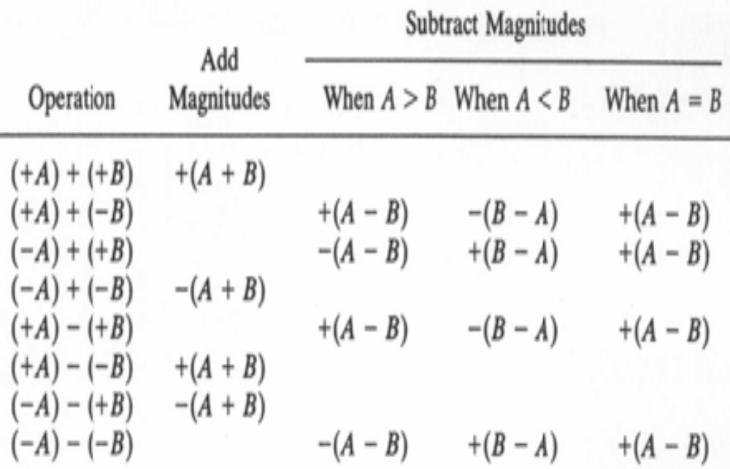
Addition and Subtraction of signed magnitude numbers

Slide 6
Hardware for signed magnitude addition and subtraction
AVF- add overflow flip flop
B_{S}
B Register
AVF
Complementer
M (Mode Control)
Output
carry
E
Parallel adder
Input carry
S
A_{S}
A Register
Load Sum

Slide 7
Hardware Implementation
It consists of registers A and B and sign flip flops A_{s} and B_{s.}
Subtraction is done by adding A to the 2’s complement of B.
The output carry is transferred to flip flop E, where it can be checked to determine the relative magnitudes of the two numbers. The add-overflow flip-flop AVF holds the overflow bit when A and B are added.
The A register provides other micro operations that may be needed when we specify the sequence of steps in the algorithm.

Slide 8
Hardware Implementation (cont..)
The addition of A plus B is done through the parallel adder. The S (sum) output of the adder is applied to the input of the A register.
The complementer provides an output of B or the complement of B depending on the state of the mode control M.
The complementer consists of exclusive-OR gates and the parallel adder consists of full-adder circuits.
The M signal is also applied to the input carry of the adder. When M = 0, the output of B is transferred to the adder, the input carry is 0, and the output of the adder is equal to the sum A + B.
When M = 1, the l's complement of B is applied to the adder, the input carry is 1, and output S = A + B +1. This is equal to A plus the 2's complement of B, which is equivalent to the subtraction A - B.

Slide 9
Flow chart for add and subtract operations
Subtract operation
Add operation
Minuend in A
Subtrahend in B
Augend in A
Addend in B
= 0
A_{S} + B_{S}
= 1
= 1
A_{S} + B_{S}
= 0
A_{S} ≠ B_{S}
A_{S} = B_{S}
A_{S} ≠ B_{S}
A_{S} = B_{S}
EA ← A + B + 1
AVF ← 0
EA ← A + B
= 0
E
= 1
A < B
A ≥ B
AVF ← E
≠ 0
= 0
A ← A
A
A ← A + 1
A_{S} ← A_{S}
A_{S} ← 0
END
(Result in A and A_{S})

Slide 10
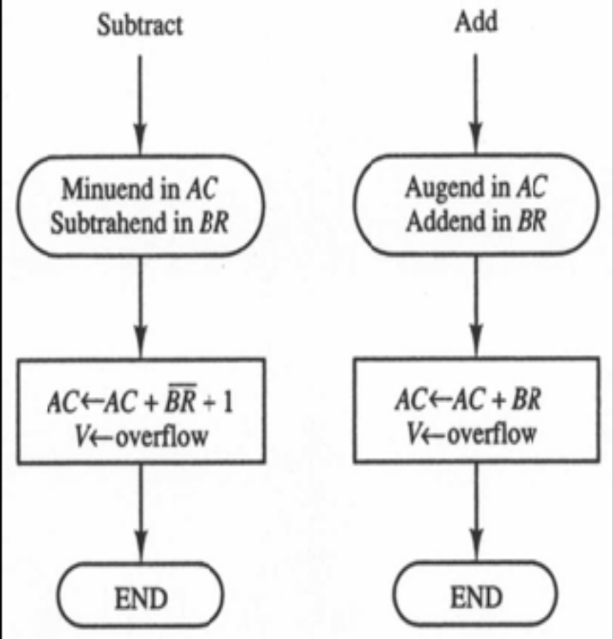
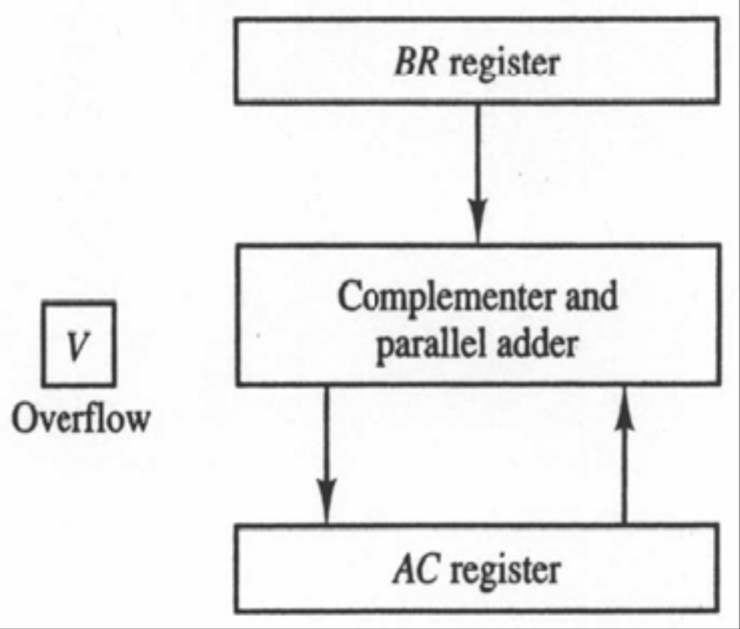
Signed 2’s complement addition and subtraction
Hardware :
Flowchart :

Slide 11
References
Text Book
M. M. Mano, Computer System Architecture, Prentice-Hall,2004

